Slide 1
Ch 1.2:
Solutions of Some Differential Equations
Recall the free fall and owl/mice differential equations:
These equations have the general form y' = ay - b
We can use methods of calculus to solve differential equations of this form.

Slide 2
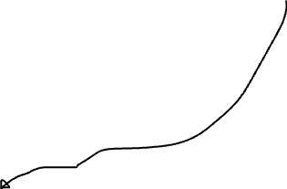

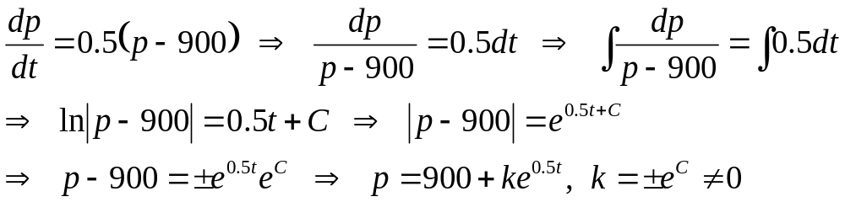
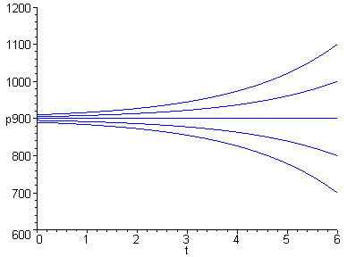


Example 1: Mice and Owls (1 of 3)
Need to let p=/=900 here
To solve the differential equation
we use methods of calculus, as follows (note what happens when p = 900).
This gives one group of solutions
where k is a non-zero constant.
Note: is also an equilibrium solution

Slide 3
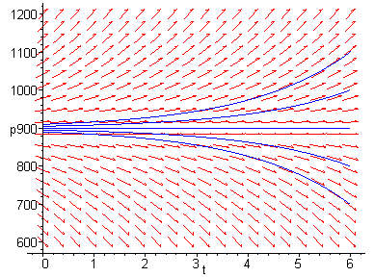
Example 1: Integral Curves (2 of 3)
Thus, all the solutions to this equation, obtained in two different solution methods, may be included in a single expression (which may not be always possible for other cases)
where k is an arbitrary constant, nonzero or zero.
Graphs of solutions (integral curves) for several values of k, and direction field for differential equation, are given below.
Choosing k = 0, we obtain the equilibrium solution, while for k ≠ 0, the solutions diverge from equilibrium solution.

Slide 4
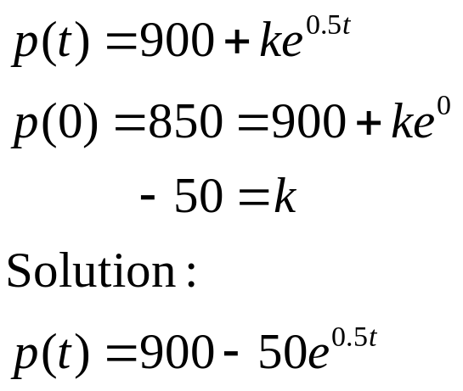
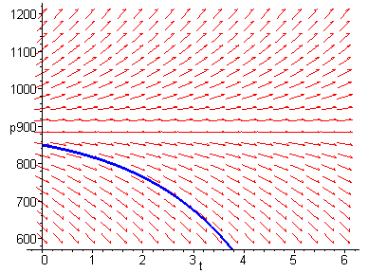
Example 1: Initial Conditions (3 of 3)
A differential equation often has infinitely many solutions. If a point on the solution curve is known, such as an initial condition, then this determines a unique solution.
In the mice/owl differential equation, suppose we know that the mice population starts out at 850. Then p(0) = 850, and

Slide 5

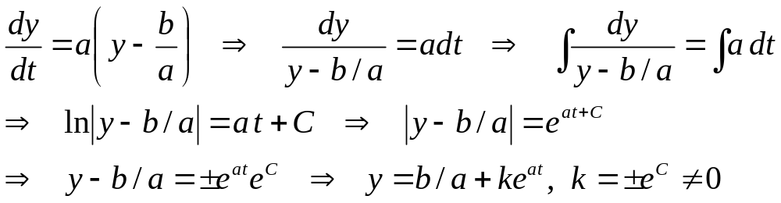
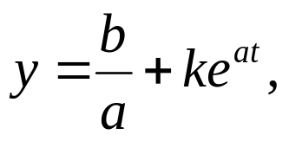
Solution to General Equation
To solve the general equation (a ≠0)
we use methods of calculus, as follows (y ≠b/a).
Thus the general solution is, combining the equilibrium solution y = b/a,
where k is a constant (k = 0 -> equilibrium solution).
Special case a = 0: the general solution is y = -bt + c

Slide 6

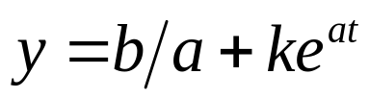
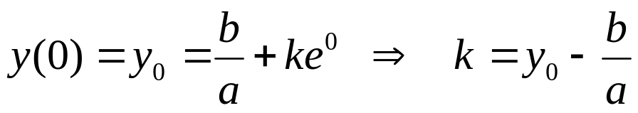
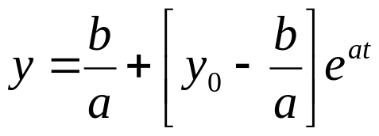
Initial Value Problem
Next, we solve the initial value problem (a ≠0)
From previous slide, the solution to differential equation is
Using the initial condition to solve for k, we obtain
and hence the solution to the initial value problem is

Slide 7
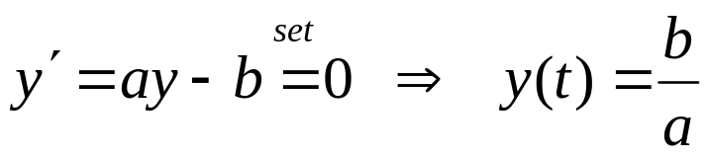
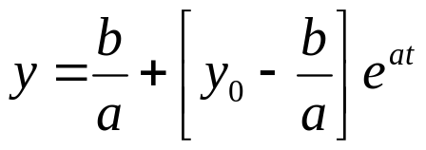
Equilibrium Solution
Recall: To find equilibrium solution, set y' = 0 & solve for y:
From previous slide, our solution to initial value problem is:
Note the following solution behavior:
  If y₀ = b/a, then y is constant, with y(t) = b/a
  If y₀ > b/a and a > 0 , then y increases exponentially without bound
  If y₀ > b/a and a < 0 , then y decays exponentially to b/a
  If y₀ < b/a and a > 0 , then y decreases exponentially without bound
  If y₀ < b/a and a < 0 , then y increases asymptotically to b/a

